Slide 1
Optimizing SpMV in accordance with HPCG Benchmark
Presented By:
Ahmed Abdullah
Mohammad Rohaan
Presented To:
Muhammad Rizwan

Slide 2

High
Performance
Conjugate
Gradient
Designed for real-world workloads
Focuses on:
Memory access
Sparse computations
Iterative solvers
More realistic than HPL (Linpack)

Slide 3
Why
HPCG is Important
Real reason applications use:
1
Memory access
Sparse computations
Iterative solvers
More realistic than HPL (Linpack)
Climate models
Structural simulations
CFD problems
HPCG Simulates:

Slide 4

Main Kernels in HPCG
SpMV (Sparse Matrix-Vector Multiplication)
SymGS(Symmetric Gauss-Seidel)
Multigrid(MG.)
Dot Product
Vector Updates(WAXPBY)

Slide 5
Why we selected SpMV
Most time consuming Kernel
Memory Bandwidth limited
Appears in every CG iteration
Small Improvements bring
meaningful Impacts

Slide 6
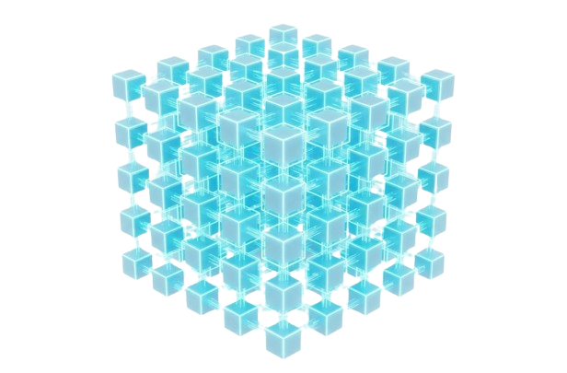
Our process is easy
=
A
x
Y
Sparse Matrix
Output Vector
Input Vector
SpMV multipies a sparse matrix
with a vector, which is the core operation
in the CG solver

Slide 7
Our Optimisation Strategy
We utilized 4-way loop Unrolling:
Reduces loop overhead
Improves register reuse
Better instruction-level parallelism
No change in data structures
This project is inspired by CVR: Efficient Vectorization of SpMV on x86 processors, which focuses on improving Sparse Matrix-Vector Multiplication using vectorization and cache-friendly memory access. Instead of implementing the full CVR format, a simpler loop-unrolling optimization was applied to the HPCG SpMV kernel.

Slide 8
Where the Code was Modified
Inner SpMV loop
optimized
Src/ComputeSPMV-ref.cpp
HPCG components unchanged

Slide 9
System Architecture
4000
3000
2000
1000
0
Intel Core i5-5300U
@2.30 GHz
8
GB RAM
Running Linux
(WSL)
2 core
Processor w/
4 Threads

Slide 10

Experimental Setup
Grid Size 16x16x16
Run-Time: 30 seconds
Baseline: Original SpMV
Optimized: Unrolled SpMV
Two runs performed:

Slide 11

BASELINE PERFORMANCE
Metric | Value
SpMV Time | 24.6904s
SpMV GFLOP/s | 0.123072
Total Time | 157.837s
Total GFLOP/s | 0.1307

Slide 12
Optimized Performance
SpMV time: 24.4821s
SpMV GFLOP/s: 0.124118
Total time: 165.699s
Total GFLOP/s: 0.124442

Slide 13
PERFORMANCE COMPARISON
SpMV became Faster
SpMV GFLOP/s Increased
Total HPCG Score slightly decreased
Kernel-level Improvement achieved

Slide 14

WHY TOTAL HPCG SCORE DECREASED
Multigrid
Dot products
Vector updates
HPCG includes:
SpMV is memory-bandwidth bound
CPU optimization alone gives limited global gains

Slide 15
KEY LEARNING OUTCOMES
Understanding sparse matrix computation
Kernel-level optimzaion
HPCG benchmrk and System Architecture analysis
Benchmarking and Performance analysis

Slide 16

CONCLUSION
SpMV kernel successfully
optimized
Visible performance improvement
Correctness preserved
Project objectives achieved

Slide 17
Ideas for the future
SIMD Vectorization
Cache Blocking
Data format optimizations (SELL, ELL, CSR)
Multithreaded SpMV

Slide 18
Thanks!
Any questions?

